Slide 1


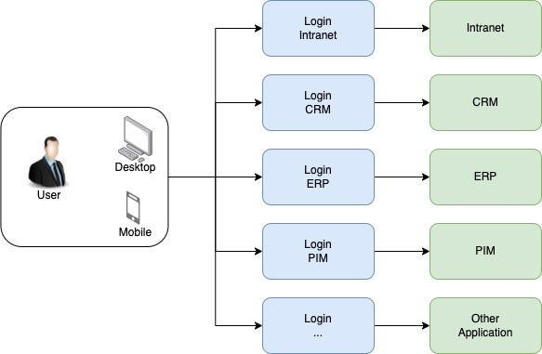

The Challenge of Multiple Logins
Fragmentation leads to security vulnerabilities and operational inefficiency.
Password Management
User need to manage extra password, security issue
Technical Complexity
Each application requires independent management of sessions, user storage, and security logic.
Access Governance Risk
Difficult to sync roles/permissions or revoke access instantly across disparate user pools.
Notes:
Password Management: User need to manage extra password
Technical Complexity: Every app has to build and manage its own login, users, and security, which is hard and time-consuming.
Access Governance Risk: Difficult to sync roles/permission or revoke access across disparate user pools

Slide 2


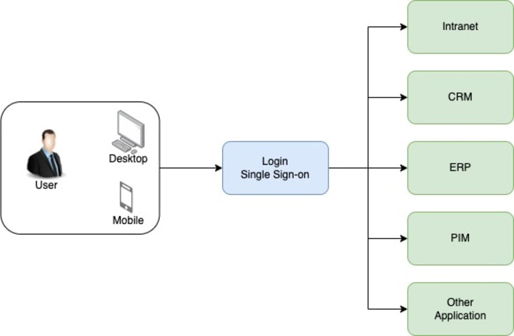









The Solution: Single Sign-On (SSO)
Centralized authentication process that allows a user to access multiple applications
Centralized Authentication
One main system checks who you are
Seamless Access
After logging in, you can open other apps without logging in again
Centralized Control
Security rules (like MFA, Password policy, Conditional access) are set in one place
"Login once -> Access many apps"
Reduces Helpdesk Tickets
Enhances User Productivity
Notes:
Centralized Authentication: One main system checks who you are.
Seamless Access: After logging in, you can open other apps without logging in again.
Centralized Control: Security rules (like MFA, Password policy, Conditional access) are set in one place.

Slide 3












Core SSO Architecture
The four pillars of centralized identity management.
User
Application (SP)
A person trying to sign in and use an app.
The application the user want to use
Identity Provider (IdP)
Tokens
A central login service (like Azure Entra ID).
Secure digital “passes” that prove who the user is and what they can access.

Slide 4









Identity Provider (IdP) - Azure Entra ID
The Central Authority in SSO Ecosystems
Azure Entra ID / B2C
The "Single Source of Truth" for authentication and authorization.
User Identity Management
Secure Authentication
Centralized user pool management, supporting full identity like create/update/disable them centrally
Provides MFA, passwordless login (FIDO2), and biometric options to verify identities securely.
Token Issuance
Policy Enforcement
Generates JWTs (ID and Access Tokens) used by applications
This is Azure deciding if login should be allowed based on location, device, and behavior.
Notes:
Icon: mostly use
User Identity Management: when user add to icon, they just need to add to the Directory of Icon. then can access to all of the application of icon (Depend on internal application also)
Token: can verify the user and permission also

Slide 5

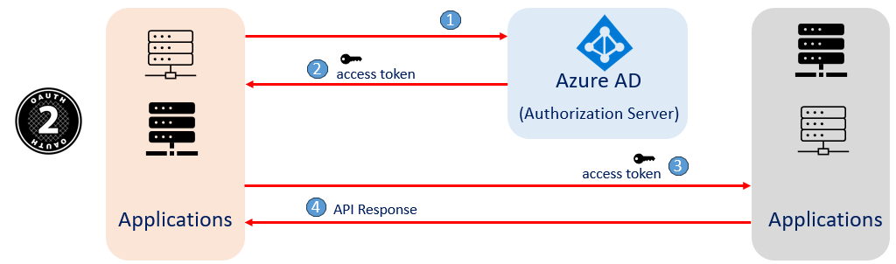
Authorization Code Flow
THE GOLD STANDARD FOR WEB & MOBILE APPLICATIONS

Slide 6
Client Credentials Flow
Secure Machine-to-Machine (M2M) Authentication

Slide 7



Client Credentials Flow
Secure Machine-to-Machine (M2M) Authentication
Authentication Process
1
Identity Request: Client sends

Slide 8


















On-Behalf-Of (OBO) Flow
Preserving User Identity Across Service Chains
01
02
03
04
Initial Call
Token Exchange
User Context
Downstream Call
User authenticates and calls API A using an access token.
API A requests a new token from the IdP using the original user token as assertion.
The IdP issues a new token for API B, maintaining the user's identity/scopes.
API A uses the new token to call API B securely on the user's behalf.
SECURITY CONSIDERATIONS
CRITICAL PARAMETERS
Grant Type
jwt-bearer
Conditional Access Failure
May fail if downstream APIs require MFA or device compliance not met by the initial token.
Assertion
User Access Token
Requested Use
on_behalf_of
User Principals Only
OBO flow is strictly for user-context operations; does not support service principals.
Client Auth
Secret or Cert
Stateless Identity
Preserves auditability and security across layered microservice architectures.

Slide 9





















Real-World Use Cases
How Single Sign-On scales across enterprise and technical ecosystems.
ENTERPRISE IDENTITY
CLOUD NATIVE
Internal Applications
Microservices & APIs
Employees navigate dozens of internal tools daily. SSO centralizes access to high-frequency systems while ensuring strict governance.
Decomposed services require consistent security. SSO enables stateless communication and preserves identity across API chains.
Streaming Platforms
e.g., Netflix profile/content sync
HR & Finance (Workday, SAP)
Project Tools (Jira, Asana)
Ride-Sharing Ecosystems
Collaboration (Teams, Slack)
Instant Access Revocation
e.g., Uber rides, delivery, & payments
ARCHITECTURE TIP
"SSO enables stateless authentication via JWT tokens, reducing server load and improving scalability."
Centralized Policy Enforcement

Slide 10











Key Benefits of SSO
Enhanced UX
Unified Security
Easy Scaling
Eliminates password fatigue and friction.
Centralized MFA & Conditional Access.
Sync user pools across 100s of apps.
Seamless cross-app navigation.
Instant access revocation (offboarding).
Rapid onboarding for new services.
Higher user satisfaction and productivity.
Reduced attack surface (no local DBs).
Consistent security posture as you grow.
EFFICIENCY STAT
11
1
SSO reduces the average number of passwords per employee
Before SSO
With SSO

